Slide 1


Brian Rashap
October 2024

Slide 2

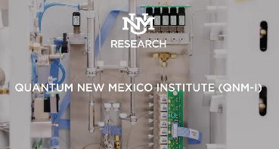

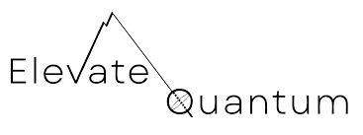
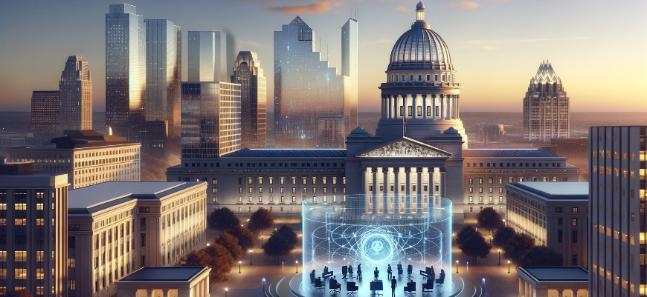



NM will be tomorrow’s quantum hotbed
Tomorrow’s quantum hotbeds? 7 U.S. cities that could incubate the next great quantum technology ecosystem
JANUARY, 2024
The University of New Mexico launches the Quantum New Mexico Institute
MARCH, 2024
Governor Polis and Governor Lujan Grisham urge the Department Of Commerce to fund the Regional Quantum Partnership
Link
MAY, 2024
New Mexico Community College receives federal funding to launch rare quantum learning lab and training program
Why?
World Class Research Institutions
Entrepreneurial Ecosystems
Pro-Innovation Government
Quantum Solutions for NM priorities
July, 2024
EDA announces $504 million in funding to 12 designated tech hubs across America
Notes:
CNM: https://www.prnewswire.com/news-releases/new-mexico-community-college-receives-federal-funding-to-launch-rare-quantum-learning-lab-and-training-program-302134947.html
Gov article: https://thequantuminsider.com/2024/03/02/governor-polis-and-governor-lujan-grisham-urge-the-department-of-commerce-to-fund-the-regional-quantum-partnership-with-phase-2-implementation-grant/
Sandia: https://newsreleases.sandia.gov/quantum_powerhouse/
UNM: https://news.unm.edu/news/the-university-of-new-mexico-launches-the-quantum-new-mexico-institute

Slide 3

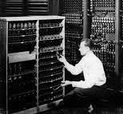


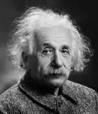

What is Quantum Information Science (QIS)?
Emerging technology that will revolutionize computing, communication and sensing:
Quantum computers to solve previously unsolvable problems
Break unbreakable cryptography and enable provably secure communications
Dramatically improve sensing and detection
The convergence two of the great scientific pillars of the 20th Century
Quantum Mechanics:
The physics of the microscopic world
Information Science:
Computers & communications
atom
electron
photon
QIS
Albert Einstein
Claude Shannon
Notes:
Quantum Information Science or “QIS” is the foundation of quantum technology that is at the cutting edge of high tech. It is the convergence of two of of the great scientific pillars of the 20th century: quantum mechanics and information science. Quantum mechanics describes the physics of the microscopic world --= atoms, electrons and photons, and information science laid the foundation of computer science and modern communications. There was a first quantum revolution that created our modern information age of computers, lasers, and broadband community. But a second quantum revolution is underway which we enable a new generation revolutionary computers, cyber security, and ultra precise sensors.

Slide 4
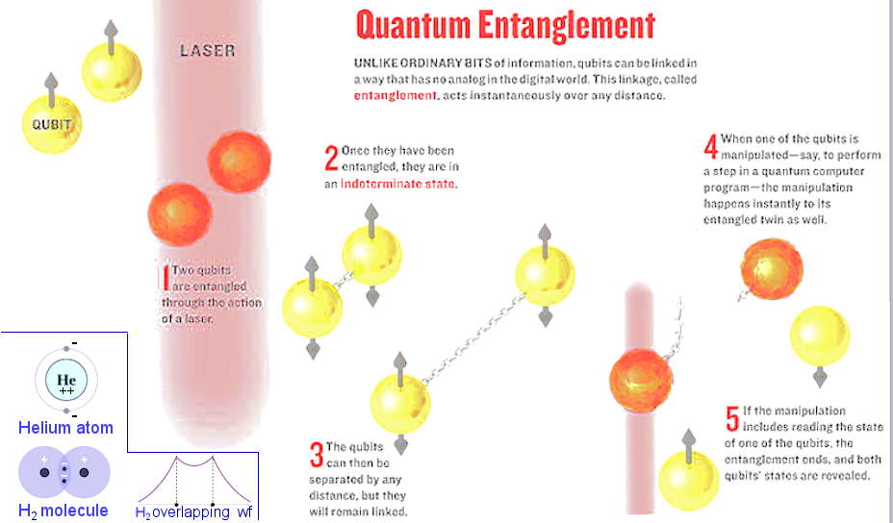
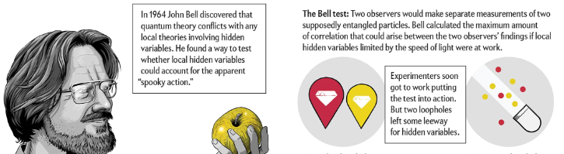
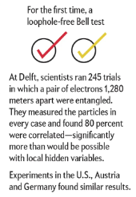
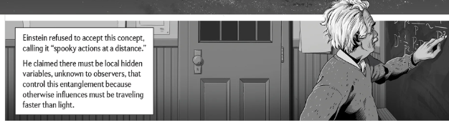
Spooky Action at a Distance (Entanglement)

Slide 5
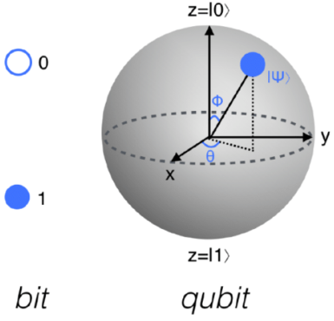
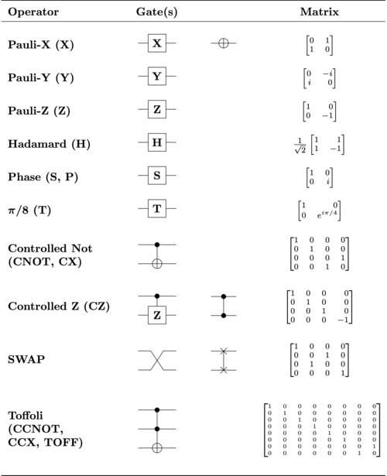
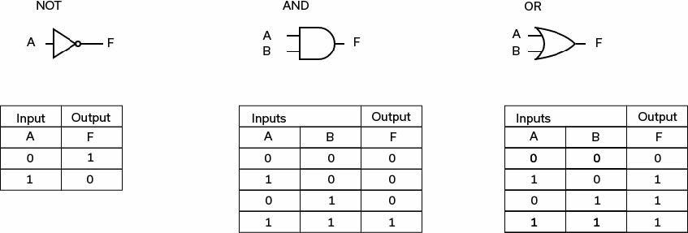
Classical vs Quantum Logic

Slide 6
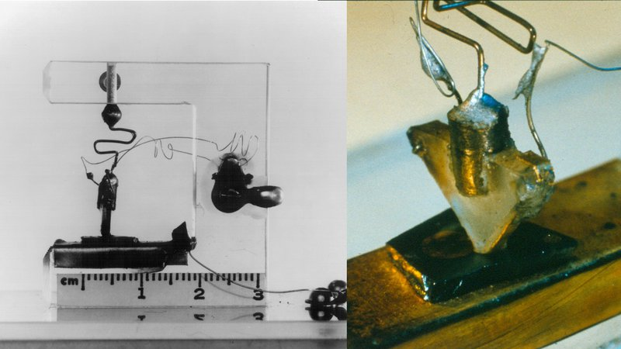
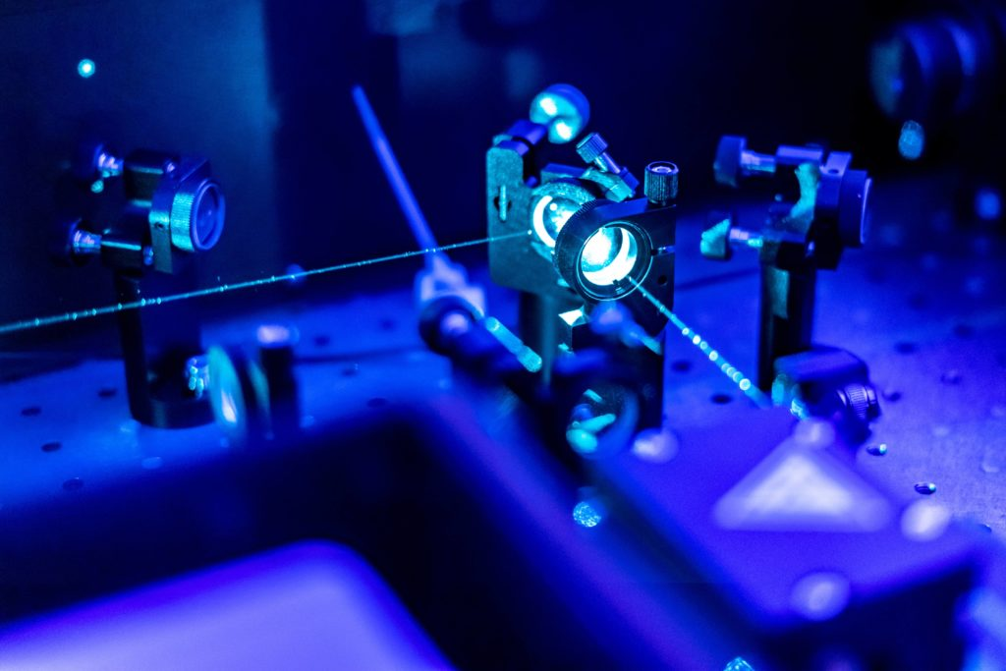
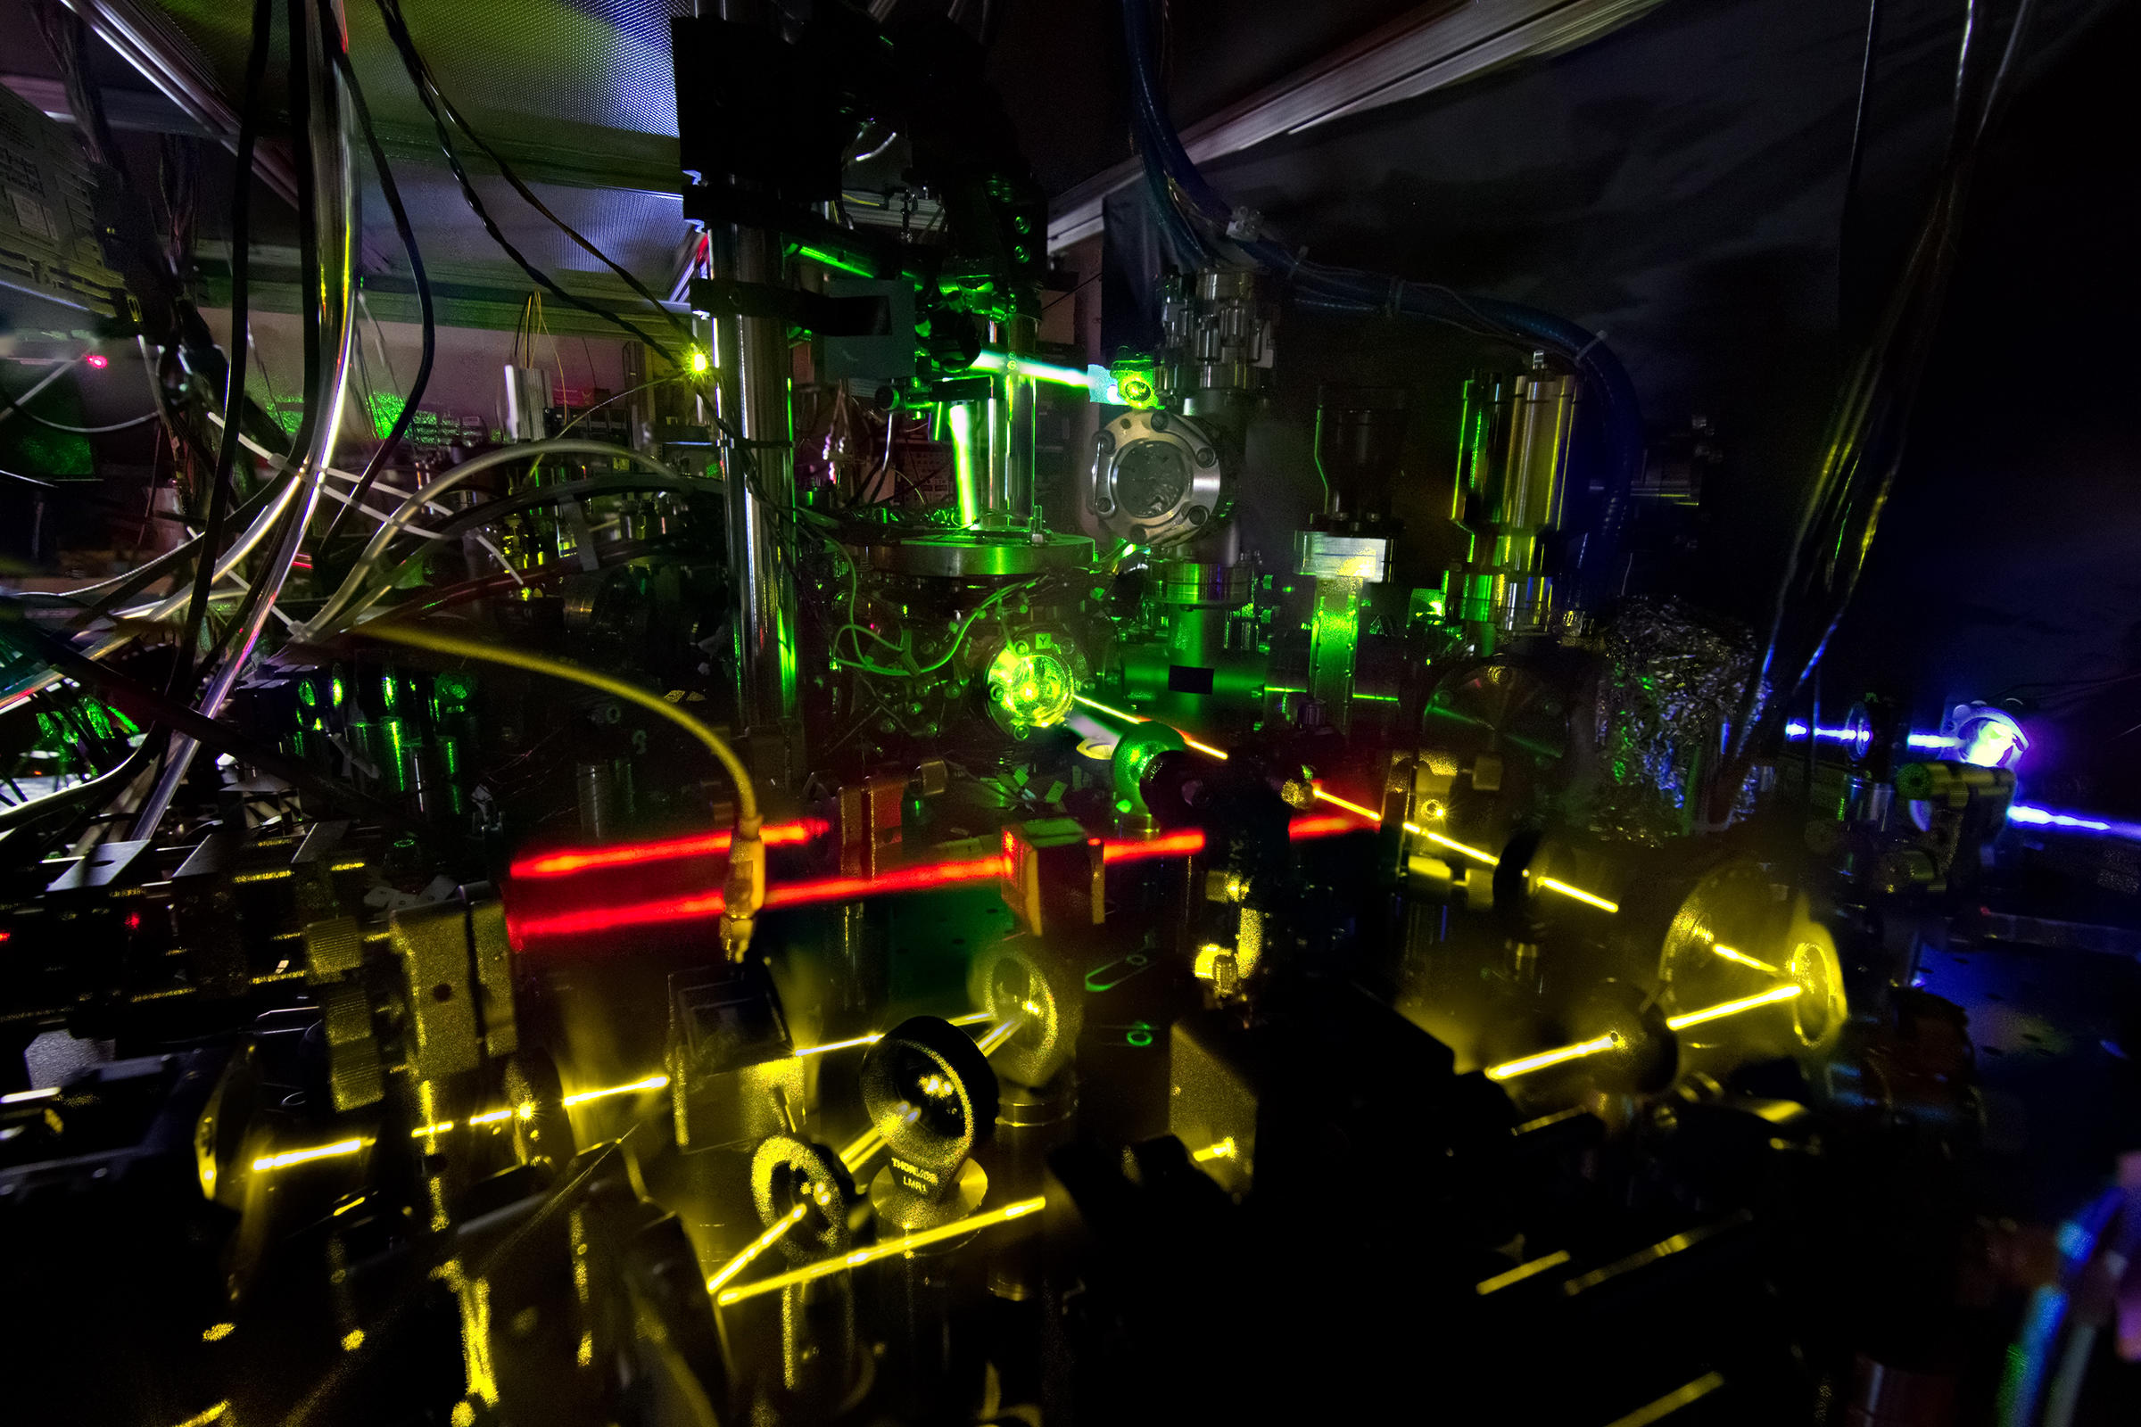
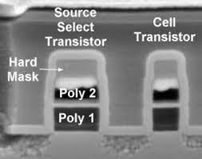
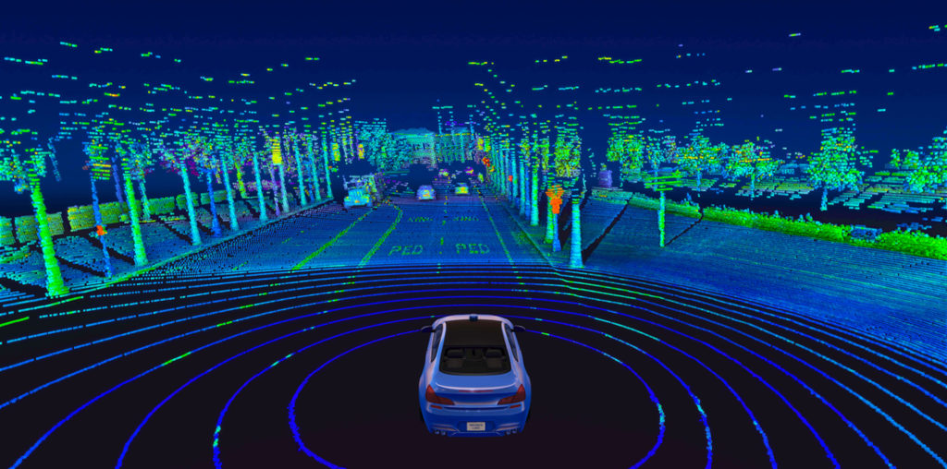
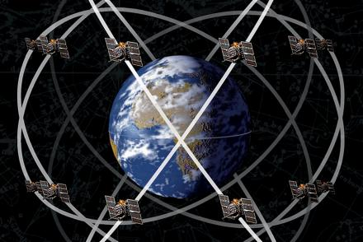
Quantum Has Been With Us
Transistors / Semiconductors
Atomic Clocks /
GPS
Lasers

Slide 7


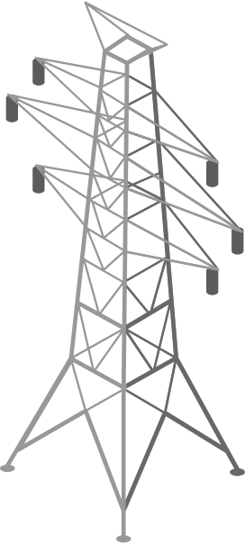










Advances in Quantum (Quantum 2.0) will supercharge the information economy
Quantum Computing
A new computing paradigm that will help us solve problems in completely new ways
Quantum Sensing
Atomic level sensors that will greatly enhance sensing capabilities
Quantum Communication
Provable secure communication and new communication protocols
BREAK SECRET CODES OR CRYPTOGRAPHY
DRUG DESIGN
OPTIMIZE THE ENERGY GRID
FRAUD DETECTION IN FINANCIAL MARKETS
THE QUANTUM INTERNET
ULTRA-SECURE COMMUNICATIONS
ENERGY EFFICIENT COMMUNICATIONS
GPS DENIED NAVIGATION
ENHANCED BIOLOGICAL SENSORS
MINERAL AND OIL EXPLORATION
7
Notes:
Quantum Information Science will supercharge the information economy of this century, and it’s happening now! Quantum computers are critical for national security. They enable us to break secret codes so it’s critical the US achieves this before our adversaries. With quantum computers we solves some of the worlds most complex problems, like designing new pharmaceutical, and optimization (like the energy gride) and other applications in financial markets. Quantum Sensors enable gps denied navigation, enhance biological sensors, and new precision for mineral and oil exploration. And QIS is critical for cyber security that is unhackable by the laws of physics, and potentially energy efficient too!

Slide 8
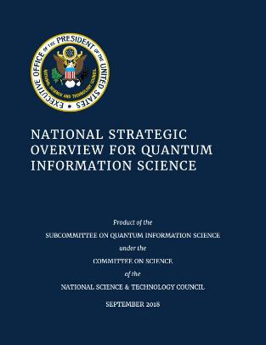
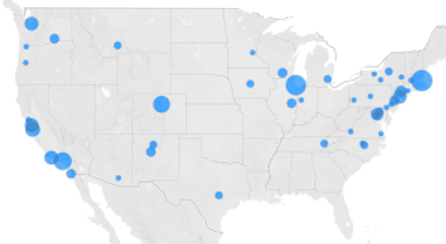
Quantum is one of the top emerging technologies in the world
Federal legislation
National Quantum Initiative (NQI): Passed in 2018, authorized $1.15B in funding to support an all of government approach to sustain national and economic security in quantum.
National Defense Authorization Act (NDAA): Passed in 2019 and 2020, legislate DOD to carry out and support quantum R&D
CHIPS and Science Act: Passed in 2021, authorized additional funding for quantum infrastructure, R&D, and workforce development programs
Federally supported quantum programs
National Science Foundation
Quantum-Leap Challenge Institutes*
Technology, Innovation and Partnerships
Department of Energy
NQI Science and Research Centers*
Office of Science - Reaching a New Energy Sciences Workforce
Department of Defense
NDAA QIS Research Centers*
Defense Advanced Research Projects Agency
Office of the Undersecretary of Defense for Research and Engineering
The 13 major NQI research centers and their affiliates (quantum.gov)
*Blue dots on the map correspond to “Federal Quantum Programs”
8

Slide 9
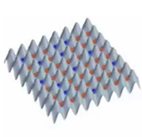
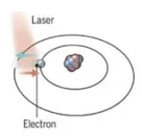
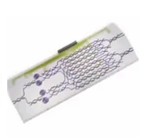
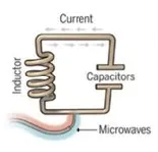
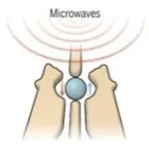

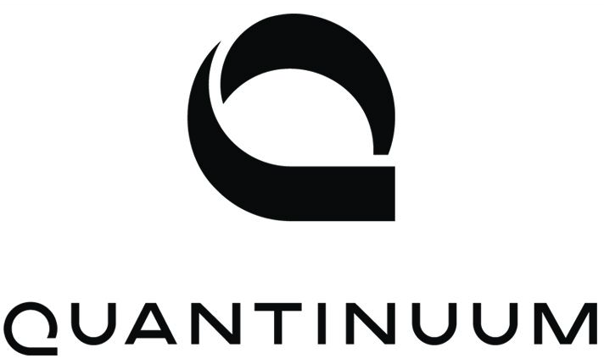














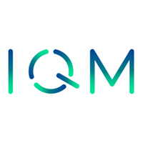
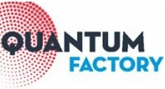












Neutral Atom | Trapped Ion | Photonics | Superconducting | Silicon Spin / Quantum Dots
Neutral atoms are cooled using tuned laser and store qubits within electron states. Interactions through excitation to Rydberg states. | Trapped Ion technology uses charged atomic particles, which can be confined and suspended in free space using electromagnetic fields. Qubits are stored in the stable electronic states of each ion. Lasers are used to induce coupling between qubits. | Photonic-based technology consists of superpositions of multiple photons in a light pulse. Qubits consist of so-called “squeeze states” consisting of superpositions of multiple photons in a light pulse | Resistance-free current oscillations back and forth around a circuit loop. An injected microwave signal excites the current into superposition states. | ”Artificial atoms” are made by adding an electron to a small piece of pure silicon. Microwaves control the electron’s quantum state.
Pros: Long coherence times. Strong connectivity including more than 2Q. External cryogenics not required. Cons: Requires ultra-high vacuum. Laser scaling challenges. | Pros: Extremely high gate fidelities and long coherence. No External cryogenics. Cons: Slow gate times / operations. Lowe connectivity between qubits. Requires ultra-high vacuum. Laser scaling challenges. | Pros: Extremely fast gate speeds and promising fidelities. No cryogenics or vacuum. Leverage existing CMOS fabs. Cons: Noise from photon loss. Each program requires custom chip. Photons don’t naturally interact so 2Q gate challenges. | Pros: High gate speeds and fidelities, Leverage existing lithographic processes. Cons: Requires cryogenic cooling. Short coherence times. Microwave interaction not well understood. | Pros: Leverage existing semiconductor technologies. Strong gate fidelities and speeds. Cons: Requires cryogenics. Only a few entangled gates with low coherence times. Interference and cross-talk challenges.

Slide 10
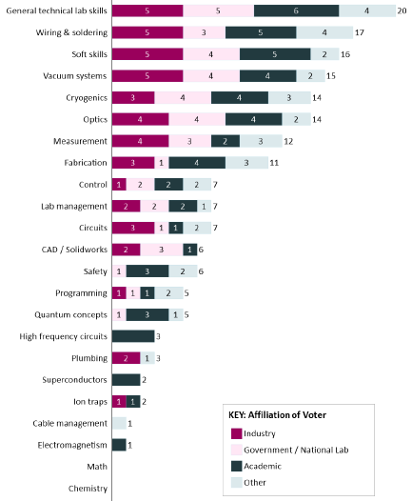
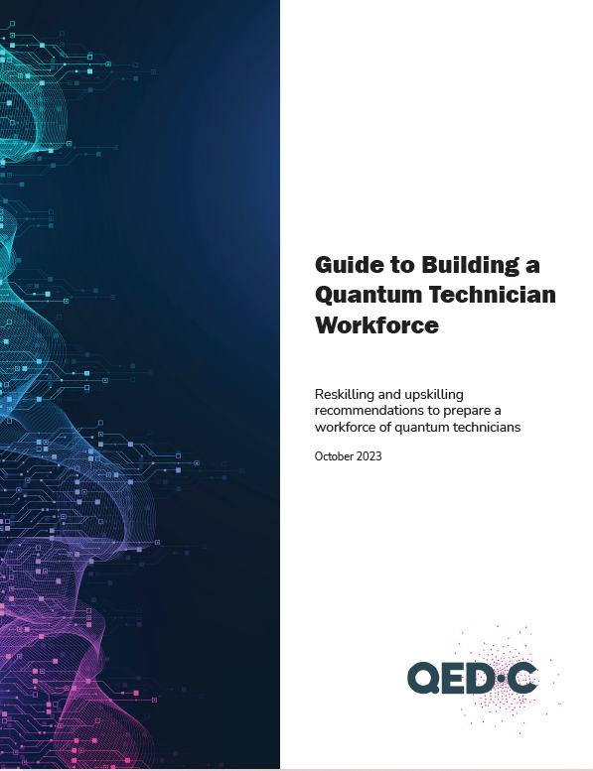
Quantum Technician Skills

Slide 11

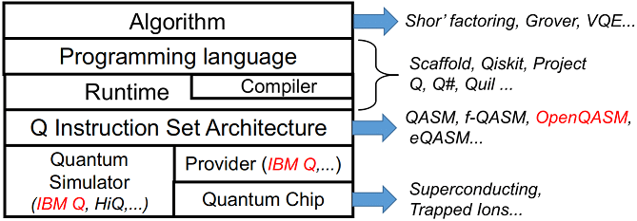






Quantum Programming Languages

Slide 12

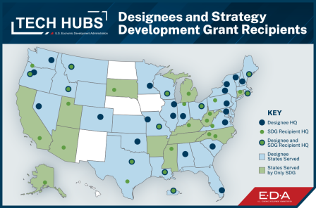
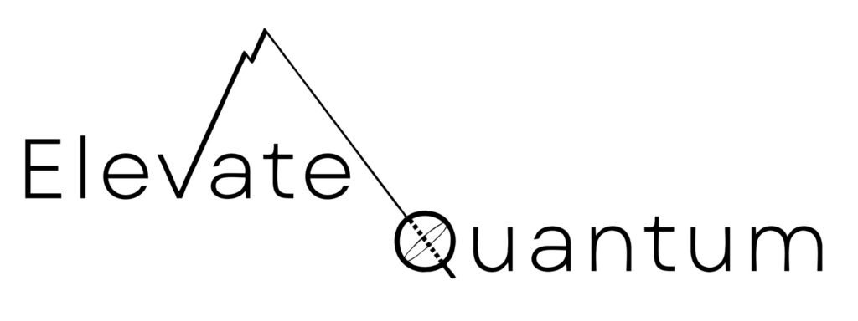
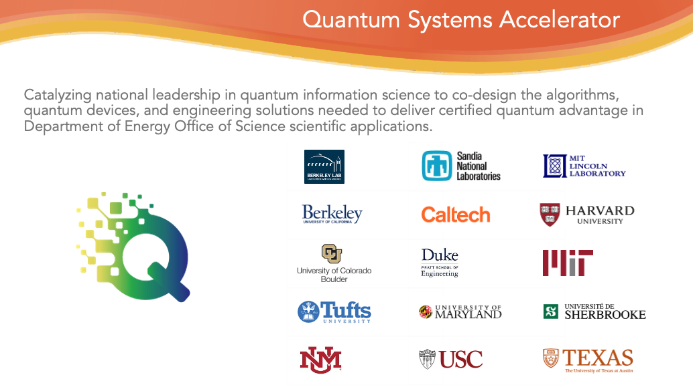
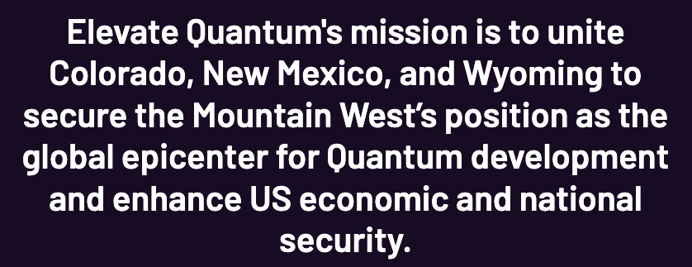
CNM Partnerships

Slide 13
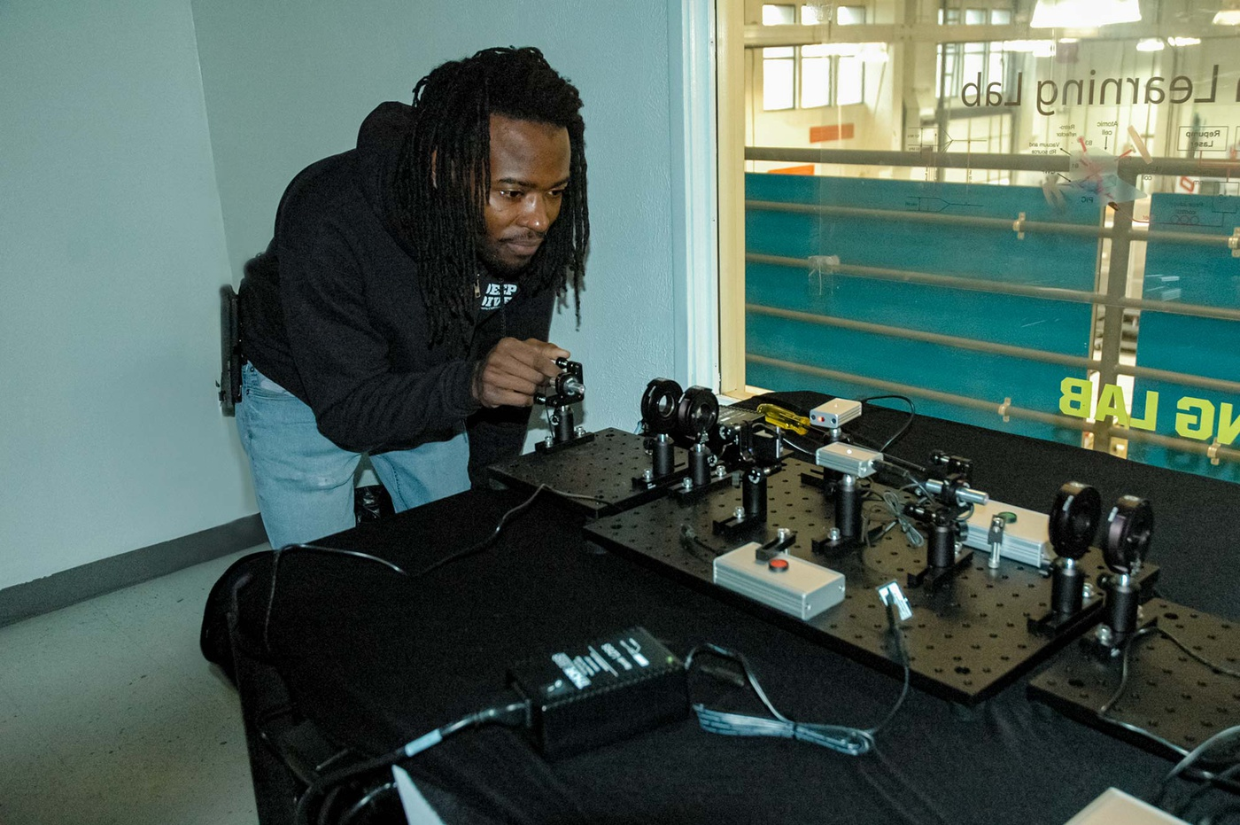
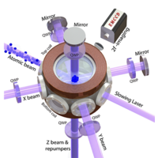
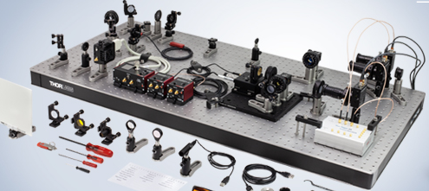
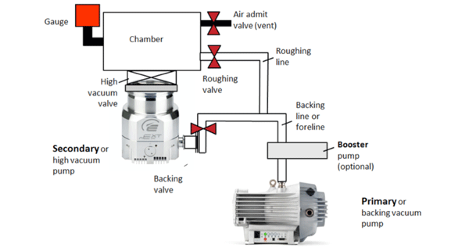

Quantum Learning Lab (QuLL)
Sandia National Labs and CNM Partnership
Training lab for Quantum Workforce Development located at the FUSE Makerspace in downtown ABQ
Provide hands-on quantum experience for University and Community College students across the state
Enhance knowledge of early-stage researchers and entrepreneurs
Immersive Hands-On Workforce Training (10-weeks)
Built on the success of CNM Ingenuity’s Deep Dive Bootcamps
No prior math/science needed
Focus on:
Optics and Photonics
Ultra-High Vacuum Systems
Quantum Phenomenon
Problem Solving, Documentation, Math, Statistics
Skills applicable to adjacent industries
Semiconductor, Solar Cell, Opto-Electronic Manufacturing
CPL opportunities with Engineering Technician (and more)
Quantum Technician Bootcamp

Slide 14
Carpe Diem
Quantum Information Systems industry is poised to revolutionize computing, sensing, and communications
Solve complex optimization problems, provide ultra secure communications, radical new sensing capabilities
National Priority: Quantum is the next technology “Space Race”
New Mexico is positioned to attract Quantum employers and grow a Quantum economy
Quantum capabilities at the SNL, LANL, AFRL, and Research Universities
Elevate Quantum Tech Hub: CNM Ingenuity is the workforce co-lead
Strong support from the Governor and State Legislature
Today, 95% of Quantum jobs require advanced degrees; however, in 5-10 years 75% of the Quantum jobs will be certificates, associate, or bachelor degrees.
The Quantum Technician Bootcamp is one of the first/only programs in the country focused on the technician workforce
We need to build a workforce by training quantum-ready technicians for adjacent industries
Jobs exist today in semiconductor, solar cell, opto-electronics and space.
A quantum-ready workforce is an enabler to NM to attract Quantum companies
Quantum Technician Bootcamp is part of a portfolio of CNM offerings for an advanced manufacturing workforce
STA - Mechatronics
Industrial Technician
Industrial Automation Technician
Ingenuity
Internet of Things
Quantum Technician
Math Science Engineering
Engineering AS degree
Engineering Technician
BHT – CS/CIS
Internet of Things
Industrial Automation

Slide 15
Back Up

Slide 16


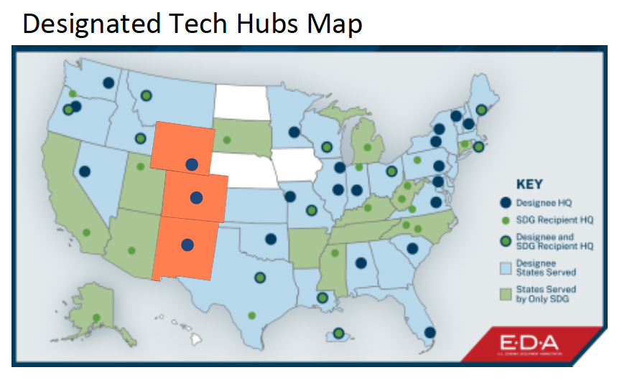
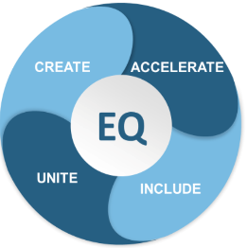
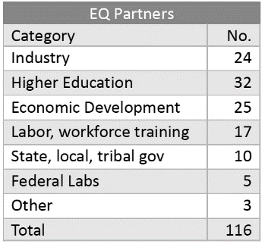
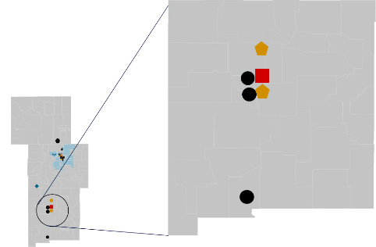




Elevate Quantum EDA Tech Hub
Keep the Mountain West on top for the quantum century
An EDA Technology and Innovation Hub
Elevate Quantum is a Mountain West regional tech hub led by Colorado and made up of 120+ partners focused on advancing Quantum Technologies
Selected as 1 of 12 Phase 2 participants, unlocking $127M of funding for the region:
$40.5M in EDA funding, $10M from State of NM*, and $76M in State of CO State incentives
Established the Mountain West as THE Quantum Tech Hub for the United States
We beat out Chicago despite the $500M investment by IL
May unlock future funding opportunities from EDA
NM will play key roles across the project
NM will establish a lab/fab aimed at accelerating quantum tech commercialization
NM will co-lead workforce development programming
Wouldn’t have been possible without support from the State of NM
*Subject to appropriation and approval
16
Notes:
Quantum technologies will be as important to the next century as integrated circuits and the internet were to the last century.

Slide 17
Quantum-Specific Investments by State Governments
SOUTH DAKOTA
$3M: Establishes a Center for Quantum Information Science and Technology (C-QIST) as a partnership between Dakota State University and South Dakota School of Mines and Technology (R&D, Education, Infrastructure/Resources)
ILLINOIS**
$200M: Support for Chicago Quantum Exchange including the development of new quantum facilities at institutions in Illinois (Infrastructure/Resources, Education)
$500M: Proposed for the development of cryogenic facility and a new quantum campus; as well as matching funds for federal grant programs (Infrastructure)
OHIO
$7M: Funds projects with Ohio-based partners to collaborate on a project titled "Quantum Sensor System using Rydberg Atoms” (R&D)
$750K: Funding to build long-distance quantum networks (Infrastructure)
INDIANA
$4M: Grant to expand the Quantum Corridor fiber network across the state, connecting data centers in Chicago, IL and Hammond, IN. (Infrastructure)
NEW YORK**
$6.5M from the Long Island Investment Fund to construct a Quantum Internet Test Bed at Stony Brook U. (R&D, Infrastructure)
MASSACHUSETTS
$1M: Supports access to the University of Mass. Boston and Western New England University to help tech companies test their quantum computer components in cryogenic test facilities (Resources)
COLORADO**
$74M incentive package to support Economic Development Administration Tech Hub (Workforce, Economic Development)
$3M in earmarked funds to support Tech Hub grant winners
$1.5M for the CUbit Quantum Initiative (Workforce)
MARYLAND**
$1.5M: Seed funding for a Quantum Science Institute at the University of Maryland, Baltimore County (R&D, Education)
$320K: Build Our Future Grant Pilot Program funding small-scale efforts to expand quantum facilities and education efforts (Infrastructure, Education)
ARIZONA**
$36M: Funding to expand the University of Arizona’s Micro/Nano Fabrication Center which has an increasing focus on quantum (R&D)
State of AZ Technology Research Initiative Fund provides support for the ASU Quantum Collaborative (R&D, Education, Economic Development)
New Mexico
(Proposed) $10M: Funding to support Economic Development Administration Tech Hub (Workforce, Economic Development)
SOUTH CAROLINA
$15M: Support for the South Carolina Quantum Association to bolster quantum education (Education)
TEXAS**
$200M: The Texas CHIPS Act will provide Texas A&M University $200M to build fabs for quantum and AI chip fabrication (Infrastructure)
**Integrated with and supported by an ecosystem of local players and investments
Notes:
Notes
Only includes funding that has been publicly announced and formally introduced or passed as legislation. Does NOT include rumored investments, letters of support, etc.
Only includes funds that are in direct support of quantum-specific activities. Some states have provided funding for broader innovative initiatives where quantum is one potential area of focus. For example, the State of Virginia approved $250M in funding for a new innovation campus at Virginia Tech where quantum is one of the focus areas. These examples are NOT included because they are not specific to quantum.
Information on New Mexico is NOT included.

Slide 18
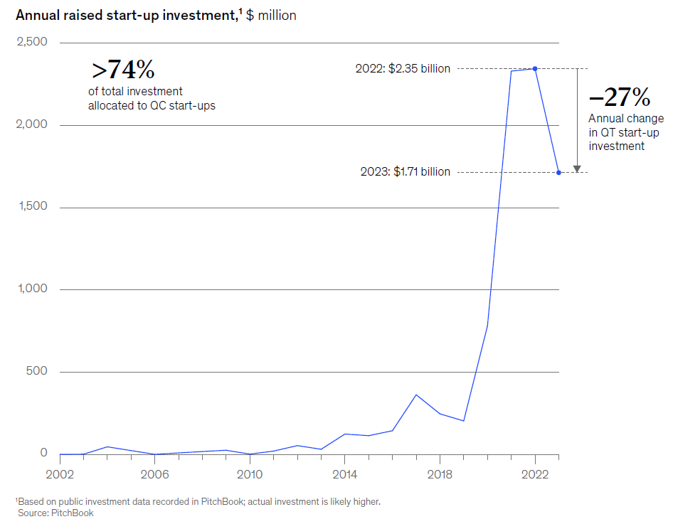
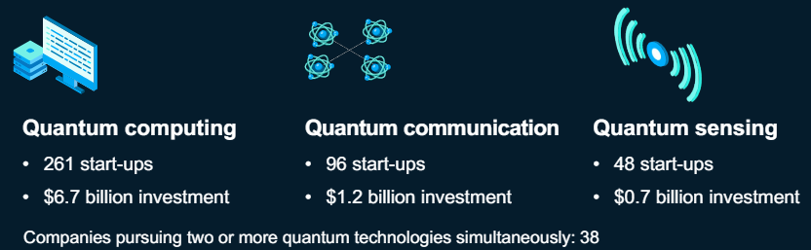
Private investment in quantum tech has been significant over the past 5 years
Quantum market is estimated to be ~$106B by 2040*
Economic impact of quantum is projected to exceed $1.3T by 2035 *
Private investments in quantum technology*
In 2022, $2.35B was raised for quantum technology startups
With economic changes there was a downshift in 2023, but there are still strong trends for the QIS industry overall
*Information reported in McKinsey Digital titled “Steady progress in approaching the quantum advantage”, April 2024.
Notes:
INVESTMENTS (info from McKinsey)
Total annual QT start-up investment hit a new high ($2.35 billion), though growth was only 1% YoY
About two-thirds, or 68 percent, of all QT startup investments since 2001 occurred in 2021 and 2022
With 350 start-ups in the QT ecosystem, the rate of start-up creation slowed and has not kept pace with investments, indicating that investments are going into established start-ups rather than toward new ideas; information that Series A and B start-ups have attracted particular attention in 2022 supports that statement
2022 was a year of big deals: four of the ten biggest QT investment deals since 2001 were closed in 2022: SandboxAQ ($500 million), Rigetti ($345 million in a SPAC deal), D-Wave ($300 million in a SPAC deal), and Origin Quantum ($149 million) — Public investments continue: the United States, the European Union, and Canada committed an additional $1.8 billion, $1.2 billion, and $0.1 billion, respectively
Potential economic value: McKinsey’s updated analysis for 2023 shows that the four industries likely to see the earliest economic impact from quantum computing—automotive, chemicals, financial services, and life sciences— stand to potentially gain up to $1.3 trillion in value by 2035.

Slide 19


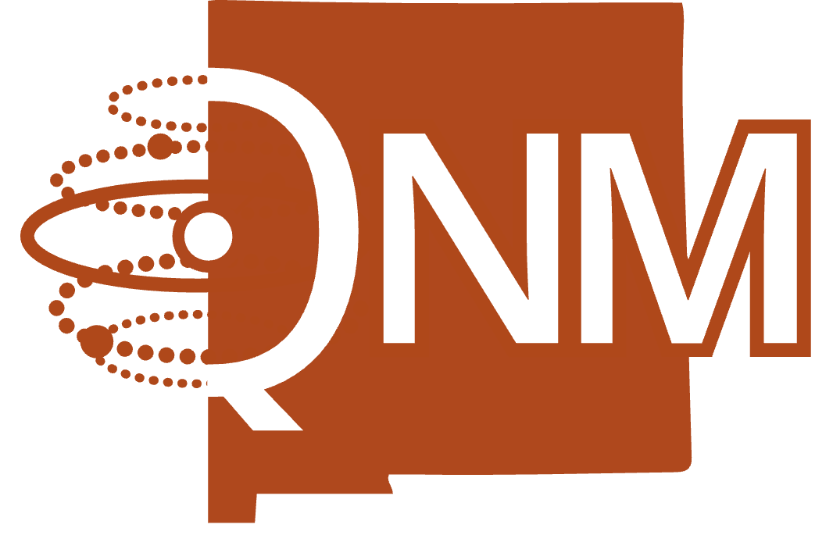





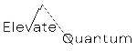
NM QIS Workforce Development Across the Spectrum
QCaMP has introduced quantum to hundreds of high school teachers and students
Launching a first of its kind quantum technician training program led by CNM
Summer schools and internships have engaged hundreds of undergrad & graduate students
Traditional higher education pathways: UNM, NMSU, NMT, CNM
Highschool
Associates
Certificates
Bachelors
Graduate
Postdoc
Additional QIS workforce opportunities
QU-REACH
Quantum Undergraduate Research Experience At CHTM
QPAQT
Quantum Photonics and Quantum Tech Graduate program
QNM Quantum Fellowships
Gil Herrera Postdoctoral Fellowship in QIS
Qu-Drive: Quantum material summer program
QCaMP High school teacher & student camps
Quantum Computing Summer School Fellowships
QIS Internship Programs
Quantum Learning Lab (QuLL)
Hands on training for NM students
Elevate Quantum Workforce Collaborative (EQWC) - Full spectrum workforce collaborative

Slide 20

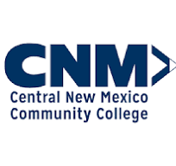
NM has been a leader in QIS technologies for decades
LANL hosts Physics of Information Conference
1989
Demonstration of free space quantum key distribution over 10 km
2000
First Sandia quantum LDRD project
2004
DOE SC National User Facility CINT
2006
The Center for Quantum Information and Control (CQuIC) launched
2009
Demonstrates atom SQUID quantum technologies
2013
Launched SECANT quantum communication Grand Challenge LDRD
2016
UNM awarded NSF Quantum Theory Hub
2019
Sandia & LANL play major roles in 2 DOE NQI Centers
2020
Elevate Quantum Designated as EDA Tech Hub
2023
Interoperable quantum networking for critical infrastructure protection
2020
Carl Caves Establishes the Information Physics Group
1992
Formed QIS working group to develop a lab-wide QIS program
2001
Center for Advanced Studies devoted to QIS
2005
Launches QIST Quantum Computing Grand Challenge LDRD
2008
Becomes a partner in the Multi-Qubit Coherent Operations Program
2010
Quantum Random Number generator invented
2015
DOE-SC Quantum Computing Testbed QSCOUT Established
2018
QNM
launched
2022
NEW MEXICO
2020s
QNM Institute established
2024
1980/1990s
2000s
2010s
…
Quantum error correction, P.W. Shor, Phys Rev A 52
1995
Microsoft launches station Q to investigate QIS
2005
ColdQuanta founded to develop quantum sensors
2007
Intel announces 17-qubit SC test chip (2017)
Quantum Economic Development Consortium (QED-C) launched
2019
IonQ, a pure play QIS company goes public
2021
INDUSTRY
IBM Quantum Experience launches, granting QC access to the public
2016
IBM starts to explore SC Qubits
Mid-2000’s
Google Quantum Supremacy Paper
2019
Quantinuum formed through merger
2021
NIST and DOD hold workshop on QIS
mid-1990s
US agencies launch QIS R&D programs
Early 2000s
QIS line item included in a US national budget 2008
UK announces 5 year, £385m investment for QIS
2015
EU commits $1.1 billion to quantum R&D
2018
EDA Announces US Tech Hub Programs
2024
China launches QIS R&D program
2006
US passes National Quantum Initiative Act, authorizing $1.2B
2019
China launches Q comm satellite for QKD
2016
GOVERNMENT
Australia launches the Centre for Quantum Computer Technology
2000
DARPA establishes the first QKD network 2003
Germany allocates € 650m for quantum R&D 2018
US Passes CHIPS and Science Act
2022
Russia announces 50b Rubles ($663m) for QIS
2019
20
Notes:
One of the messages I really want to communicate is that we are not jut chasing after the latest fad. New Mexico was a pioneer in QIS and laid the foundation with R&A over 30 years that launched the second revolution. I won’t go through all the details that on this slide, but we have the time line here in the materials for your records. We show here the pioneering milestones of UNM, Los Alamos, and Sandia National Labs, over these together with the developments in the industrial and governmental spaces, now accelerating in the 2020s.

